Slide 1
DESIGN OF CONTROL UNIT
Debkumar Chowdhury
Assistant Professor
Computer Science & Engineering

Slide 2
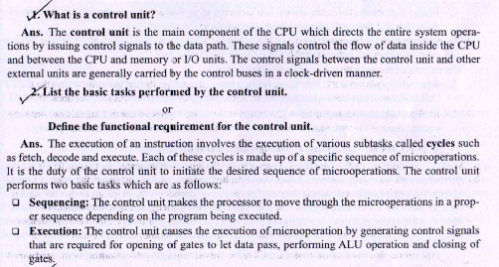
What is a Control Unit?

Slide 3
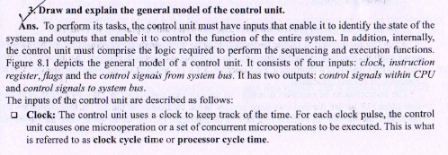
Explain general model of control unit.

Slide 4
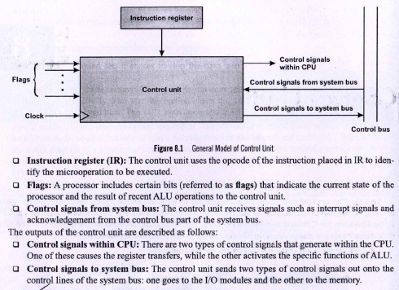
Explain general model of control unit.

Slide 5
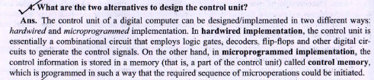
Classification of Control Unit.

Slide 6
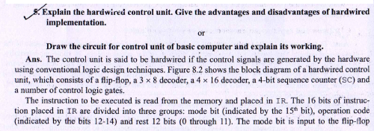
Hardwired Control Unit.

Slide 7
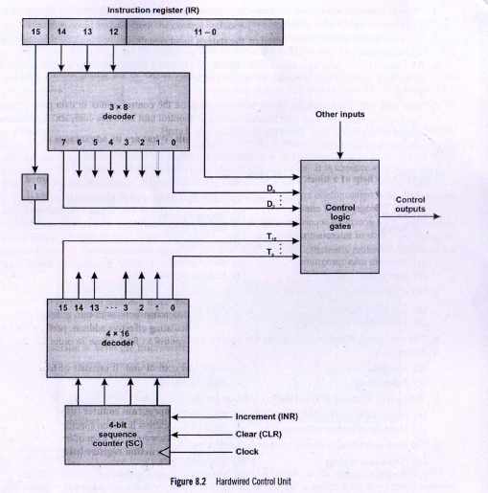
Hardwired Control Unit.

Slide 8
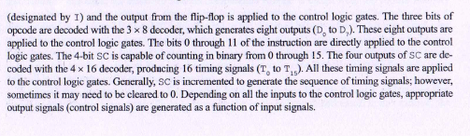
Hardwired Control Unit.

Slide 9
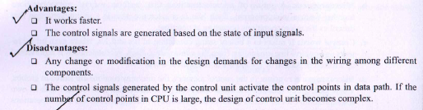
Hardwired Control Unit.

Slide 10
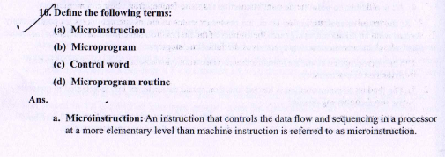
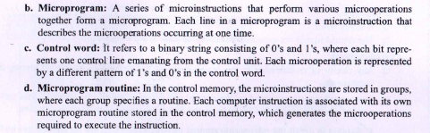

Slide 11
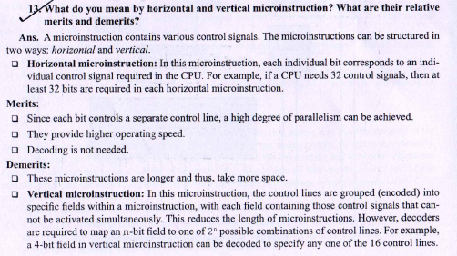
Horizontal vs Vertical Microinstruction.

Slide 12

Horizontal vs Vertical Microinstruction.

Slide 13
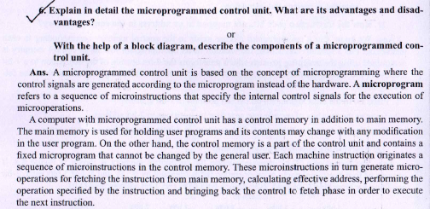
Designing Micro programmed Control Unit.

Slide 14
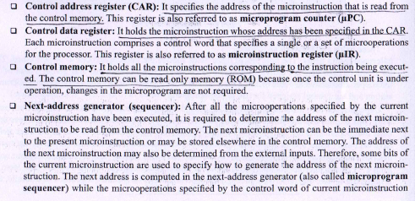
Designing Micro programmed Control Unit.

Slide 15
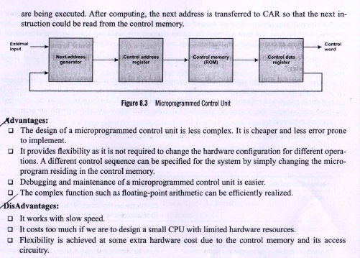
Designing Micro programmed Control Unit.

Slide 16
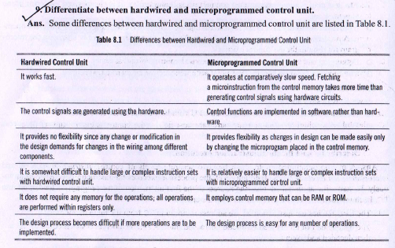
Hardwired vs Micro programmed Control Unit.

Slide 17
WBUT Last 15 Years Questions.
What is a control unit?
What do you mean by control signal?
What is a horizontal micro instruction?
What is a vertical micro instruction?
Why horizontal micro instructions are slower than its corresponding vertical micro instructions?
What are the factors which are directly involved with the length of micro instructions?
What are the features of control words?
What is a control memory?
Why H/W control unit is faster than its corresponding microprogramming CU?

Slide 18
WBUT Last 15 Years Questions.
An encoded microinstruction format is to be used in CU. Show how a 9-bit operation field can be divided into subfields to specify 46 different control signals.
Suppose there are 15 micro instructions in control memory that generates the control signals for an instruction and it takes 7 micro instructions to read an instruction from memory into IR and then to decode the instruction. Assuming a read of control memory address occurs in 1 ns, what will be the time taken by the processor for the instruction?
Draw the diagrams of horizontal and vertical instruction format.
Draw the block diagram and explain the functionality of micro programmed control unit.
What is micro programming? Compare and contrast the alternatives of microprogramming.
What are the advantages of micro programming control over hardwired control?

